Slide 1
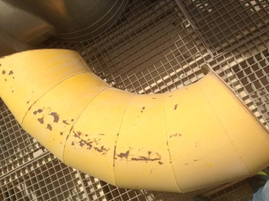
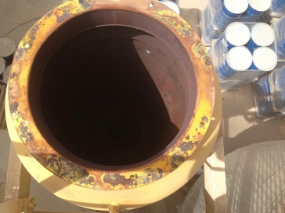
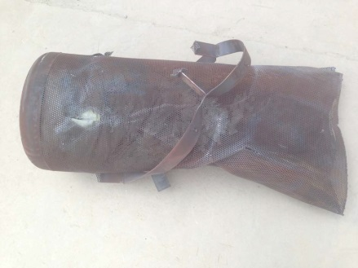
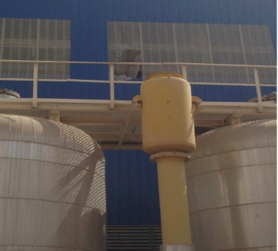
HS&E INCIDENT BULLETIN |  | 1st half year 2014
Location Country | Type of incident (example: Slip-Trip, Fall from Height, Vehicle , Laceration, Chemical Exposure)
Summary:
When starting up a plant in a foreign country, a third party software engineer mistakenly drove the valves of the first plant with consequent damage to the unit pre-purification and risks to the customer's staff this that was operating near the crushed area
Root Causes: | Actions Taken Thus Far: Next Steps
Insufficient knowledge of control system of technical staff employed Human error | Ensure skills of personnel employed on site through technical interview Ensure adequate timing for “hand over” when employed more technicians (at different times) for the same plant commissioning

